Slide 1
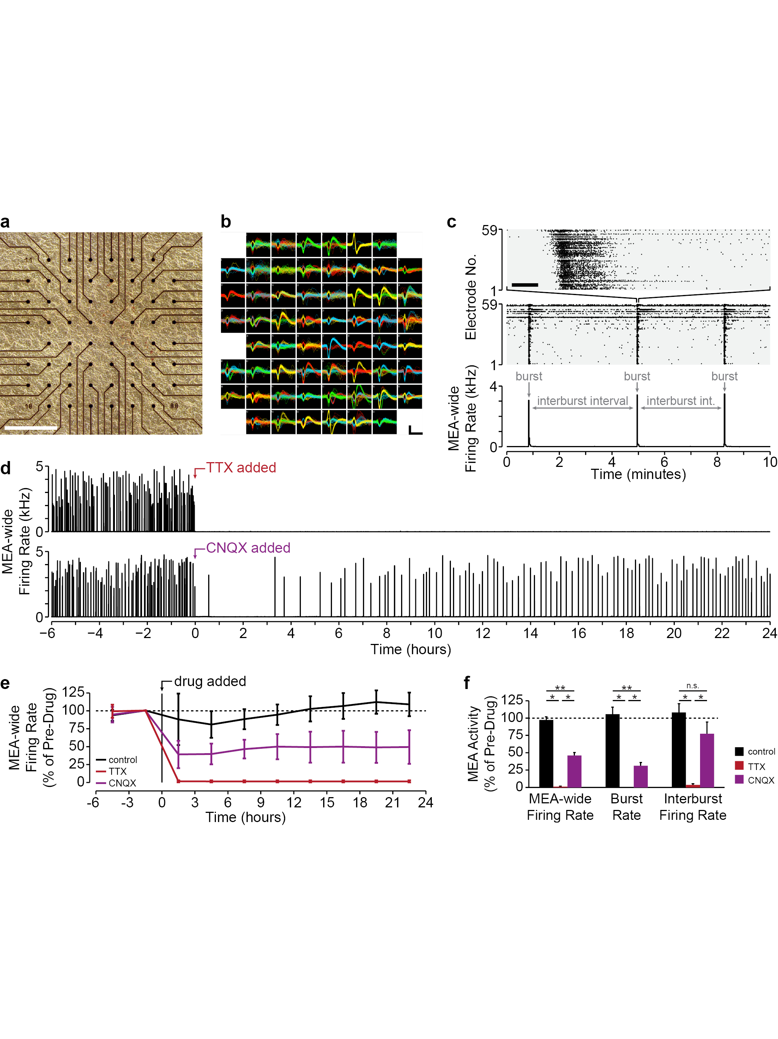
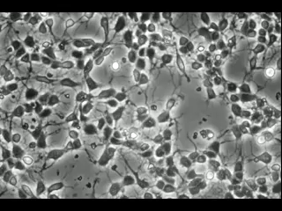
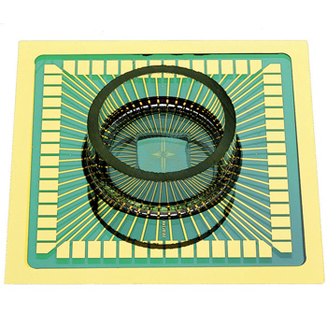
Eavesdropping on neural development using MEAs
1 DIV
2 DIV
3 DIV
4 DIV
5 DIV
6 DIV
500 μm
Dissociated cortical cultures of neurons and glia derived from E18 rat neocortex
MEA: microelectrode array
DIV: days in vitro
time-lapse video by Doug Bakkum
(Multichannel Systems)

Slide 2
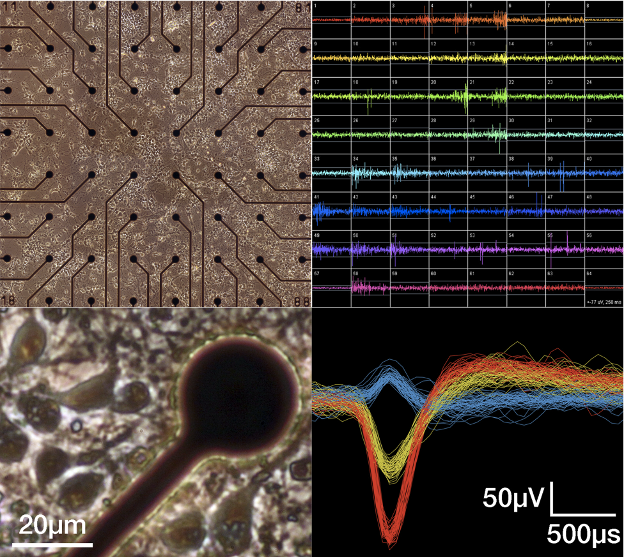
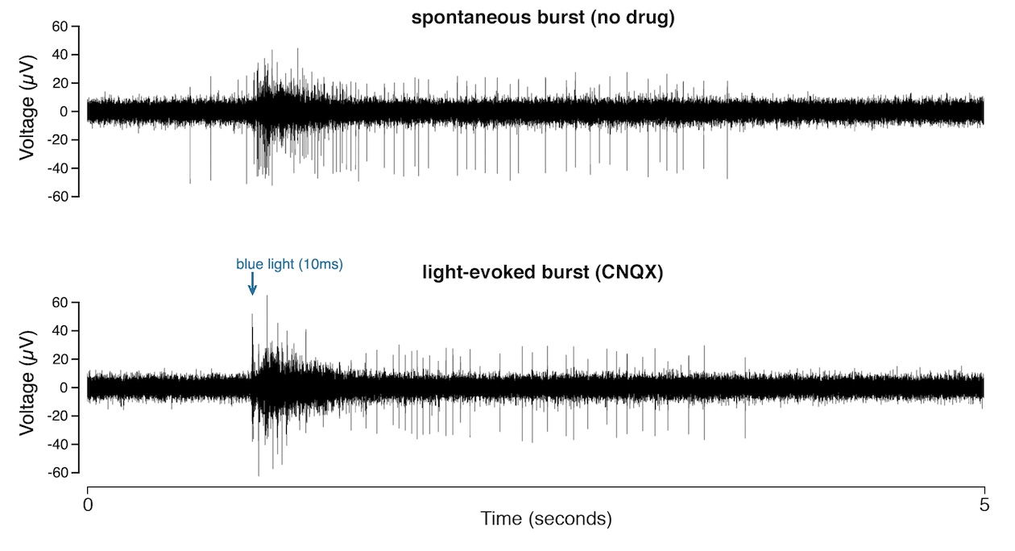
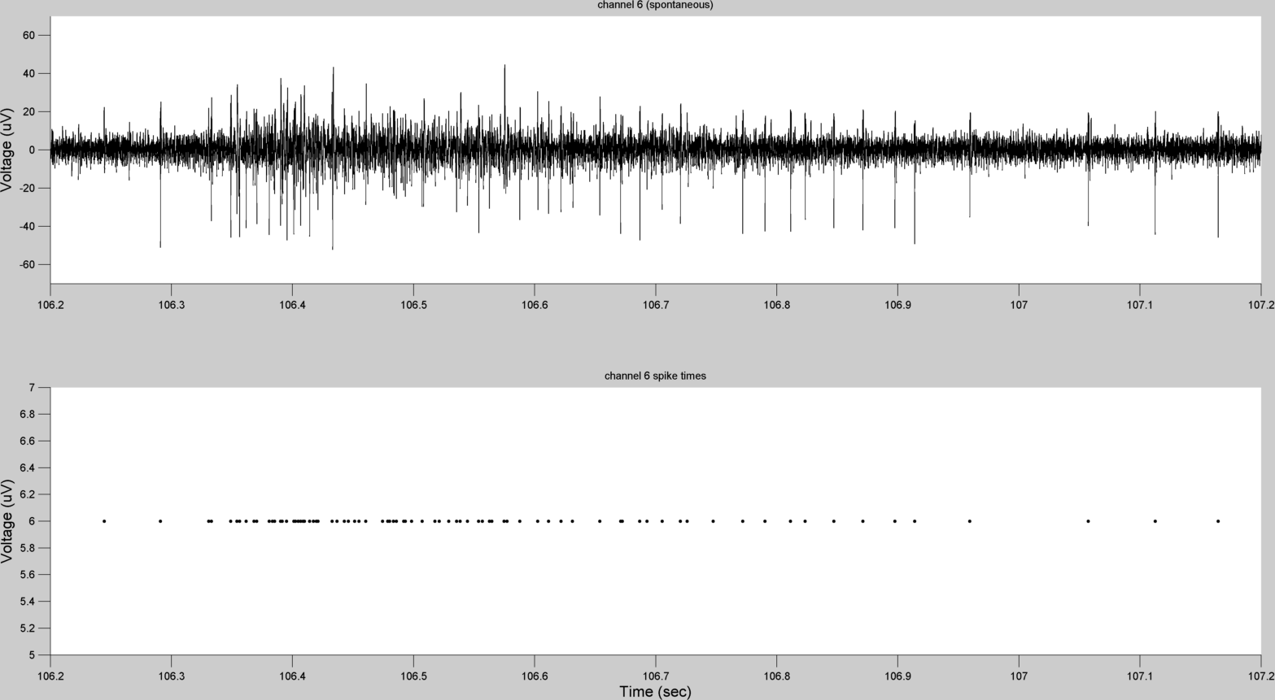
Eavesdropping on neural development using MEAs
500 μm
MEA: microelectrode array
100ms

Slide 3
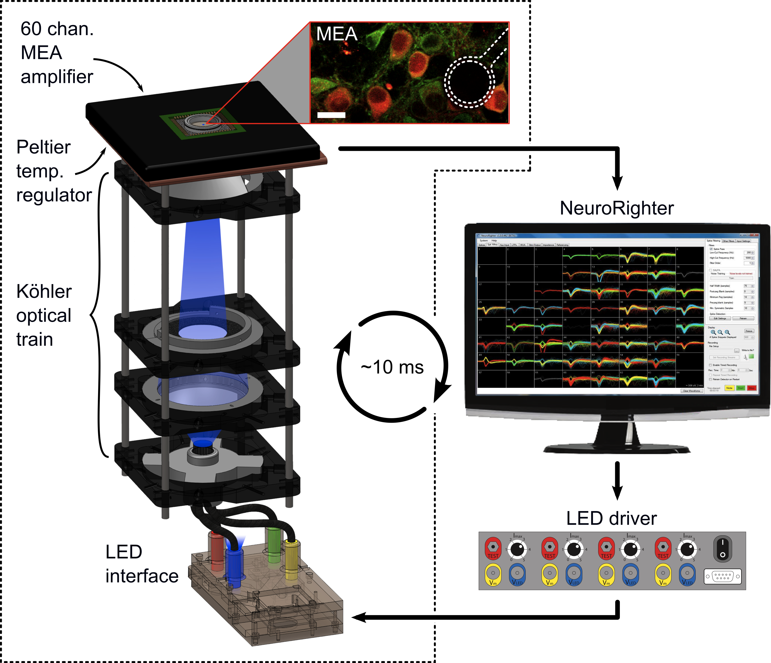

Lowering the barriers to multichannel neural recording
Cheap
~1/10th the price of commercial alternative
Open source
Hardware
Software
[1] J.P. Newman et al. (2013) Front. Neural Circuits, 6(98).

Slide 4
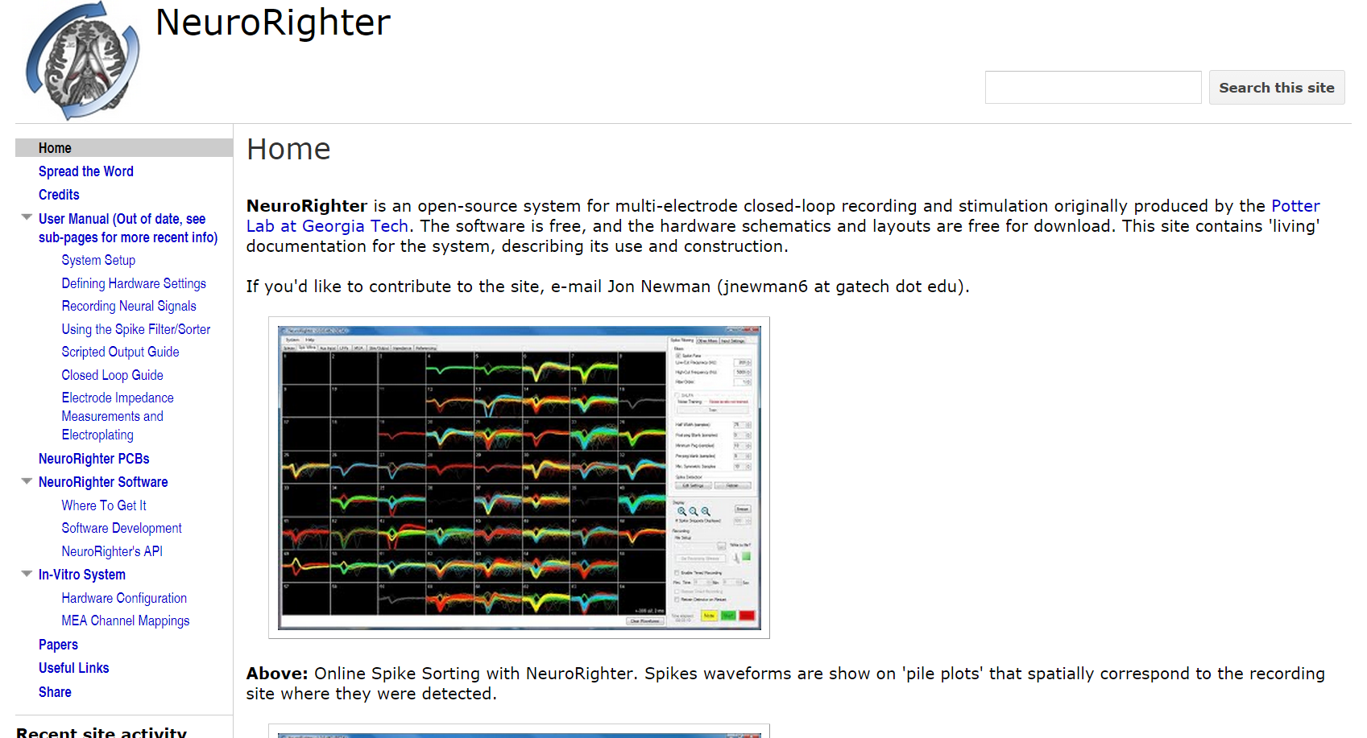
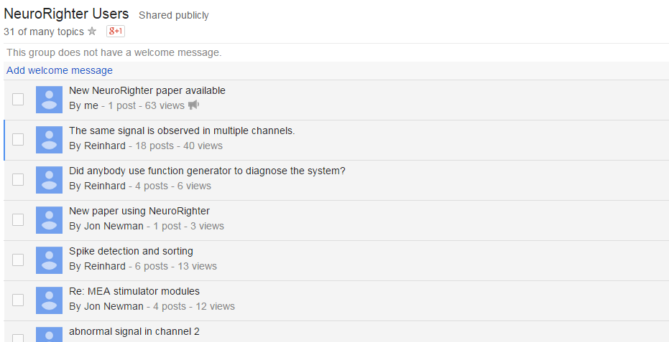
Lowering the barriers to multichannel neural recording
Cheap
~1/10th the price of commercial alternative
Open source
Hardware
Software
Extensive documentation
Website
Support forum
Users
Smaller/teaching labs
Many users outside the USA
[1] J.P. Newman et al. (2013) Front. Neural Circuits, 6(98).

Slide 5
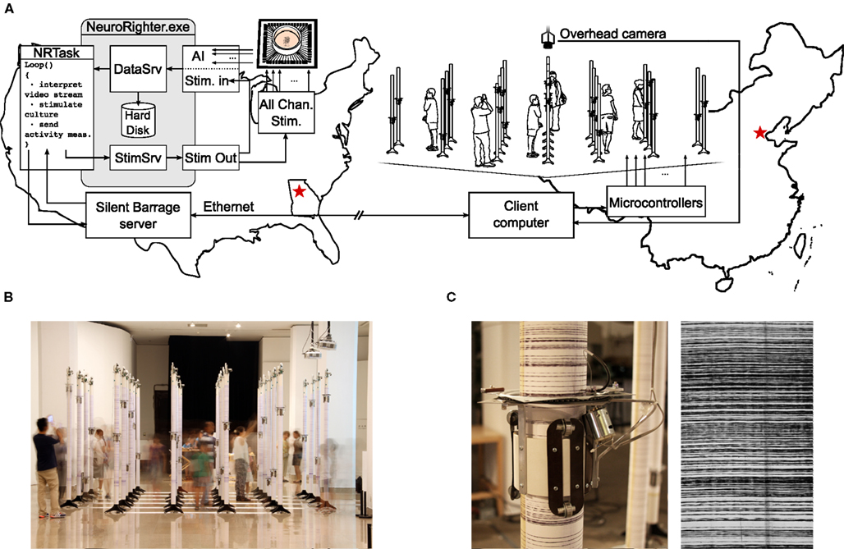


Neurorighter at the intersection of Making, Art, and Neuroscience!
NAMOC
Georgia Tech
http://silentbarrage.com/ [1] J.P. Newman et al. (2013) Front. Neural Circuits, 6(98).
Silent Barrage Team:
Riley Zeller-Towson, Doug Bakkum, Steve M. Potter, Guy Ben-Ary, Phil Gamblen, Peter Gee, Stephen Bobic, and Douglas Swehla

Slide 6
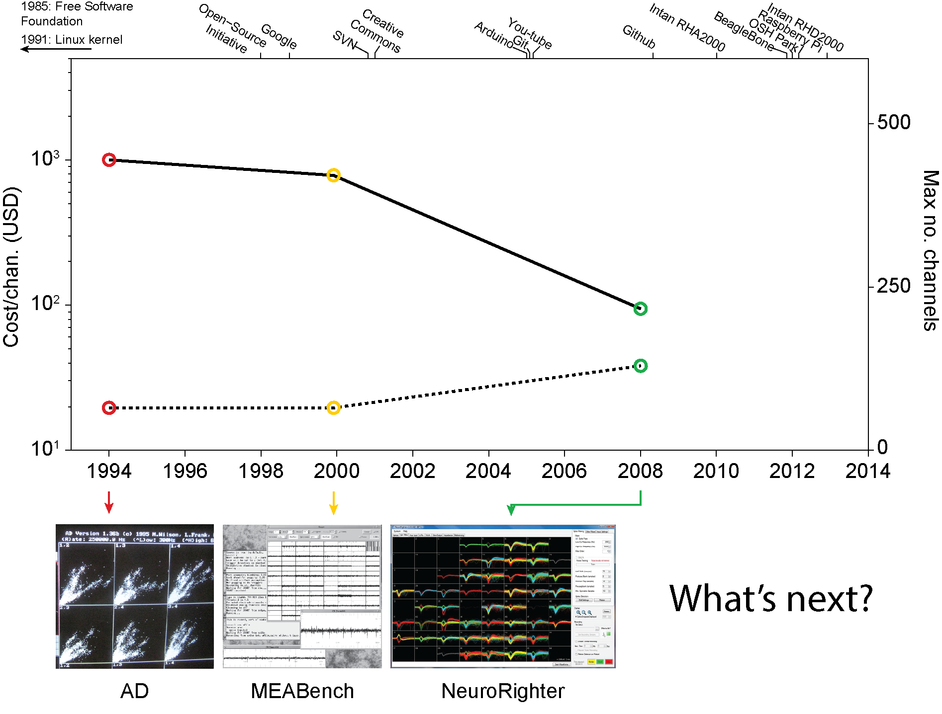
The future of open-source, multichannel systems in neuroscience

Slide 8
Appendix A
Optogenetic feedback controller

Slide 9
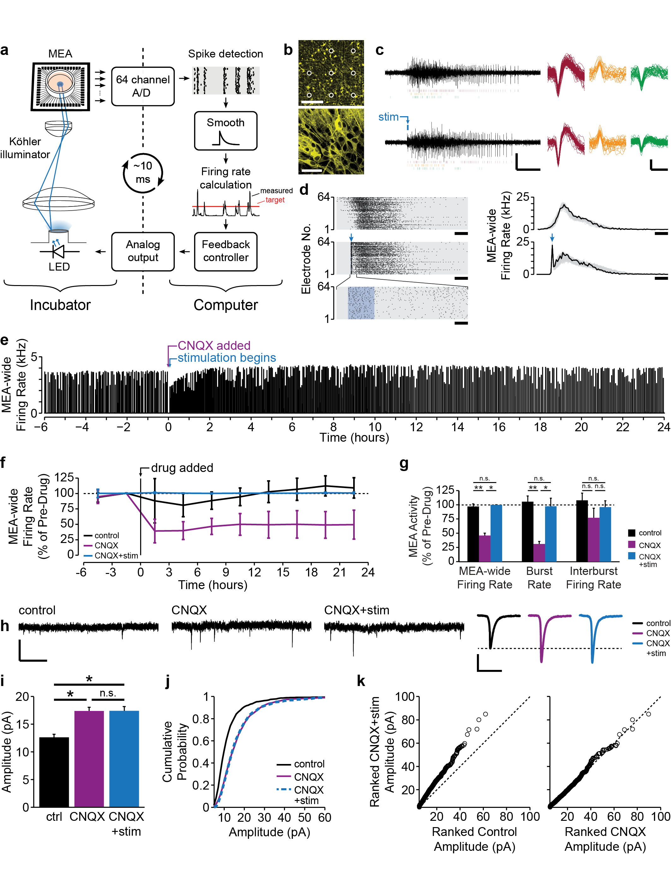
Restoring spiking using optogenetics
Aim 2a
Approach
channelrhodopsin-2 (ChR2)
microelectrode
200 μm
50 μm
construct: AAV9-hSynapsin-ChR2(H134R)-eYFP

Slide 10
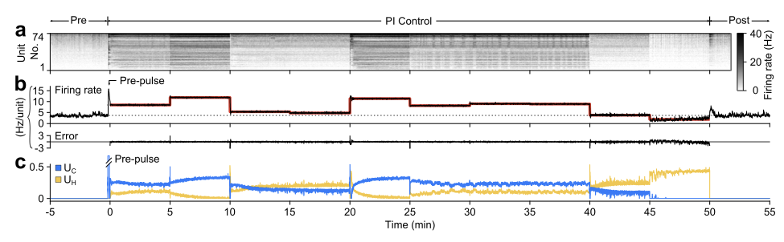
Closed-loop control of network firing rate
Appendix
Newman, Fong et al., in review.
Notes:
The lower plot shows the control effort, which illustrates two important points: First, the fluctuating signal provides impetus for the use of a closed-loop controller. The number of spikes that a stimulus can evoke is variable and conditioned on past history. Using a closed-loop controller allows the stimulus to be adjusted to account for these differences in stimulation efficacy. The second important point here is that while the controller is fluctuating, relatively little effort is needed to hold firing rate at this elevated setpoint for 12 hours.
For our synaptic scaling experiments, we’ve been able to use this controller to precisely restore spiking activity during a CNQX treatment.

Slide 11
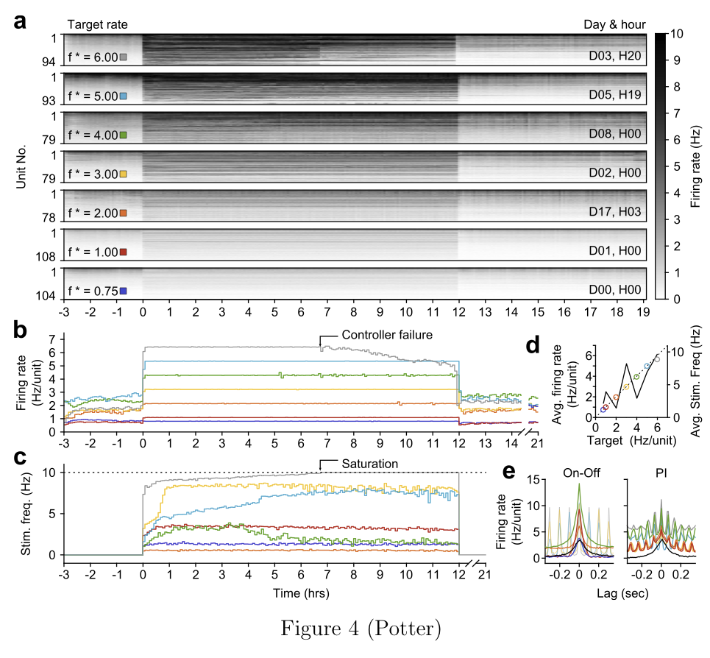
Closed-loop control of network firing rate
Appendix
Newman, Fong et al., in review
Notes:
.

